Slide 1
WHY is a
Team
Development
Conversation
meaningfull when talking about
ball games and teaching??

Slide 2
Learning in
Learning about
Learning through
Notes:
Learning in: Technical, tactical and physical elements
Learning about: the idea and characteristics of the game, the language of the game
Learning through: thematization – basketball and team developement – external outcome AND internal outcome
Tegn figur!!

Slide 3
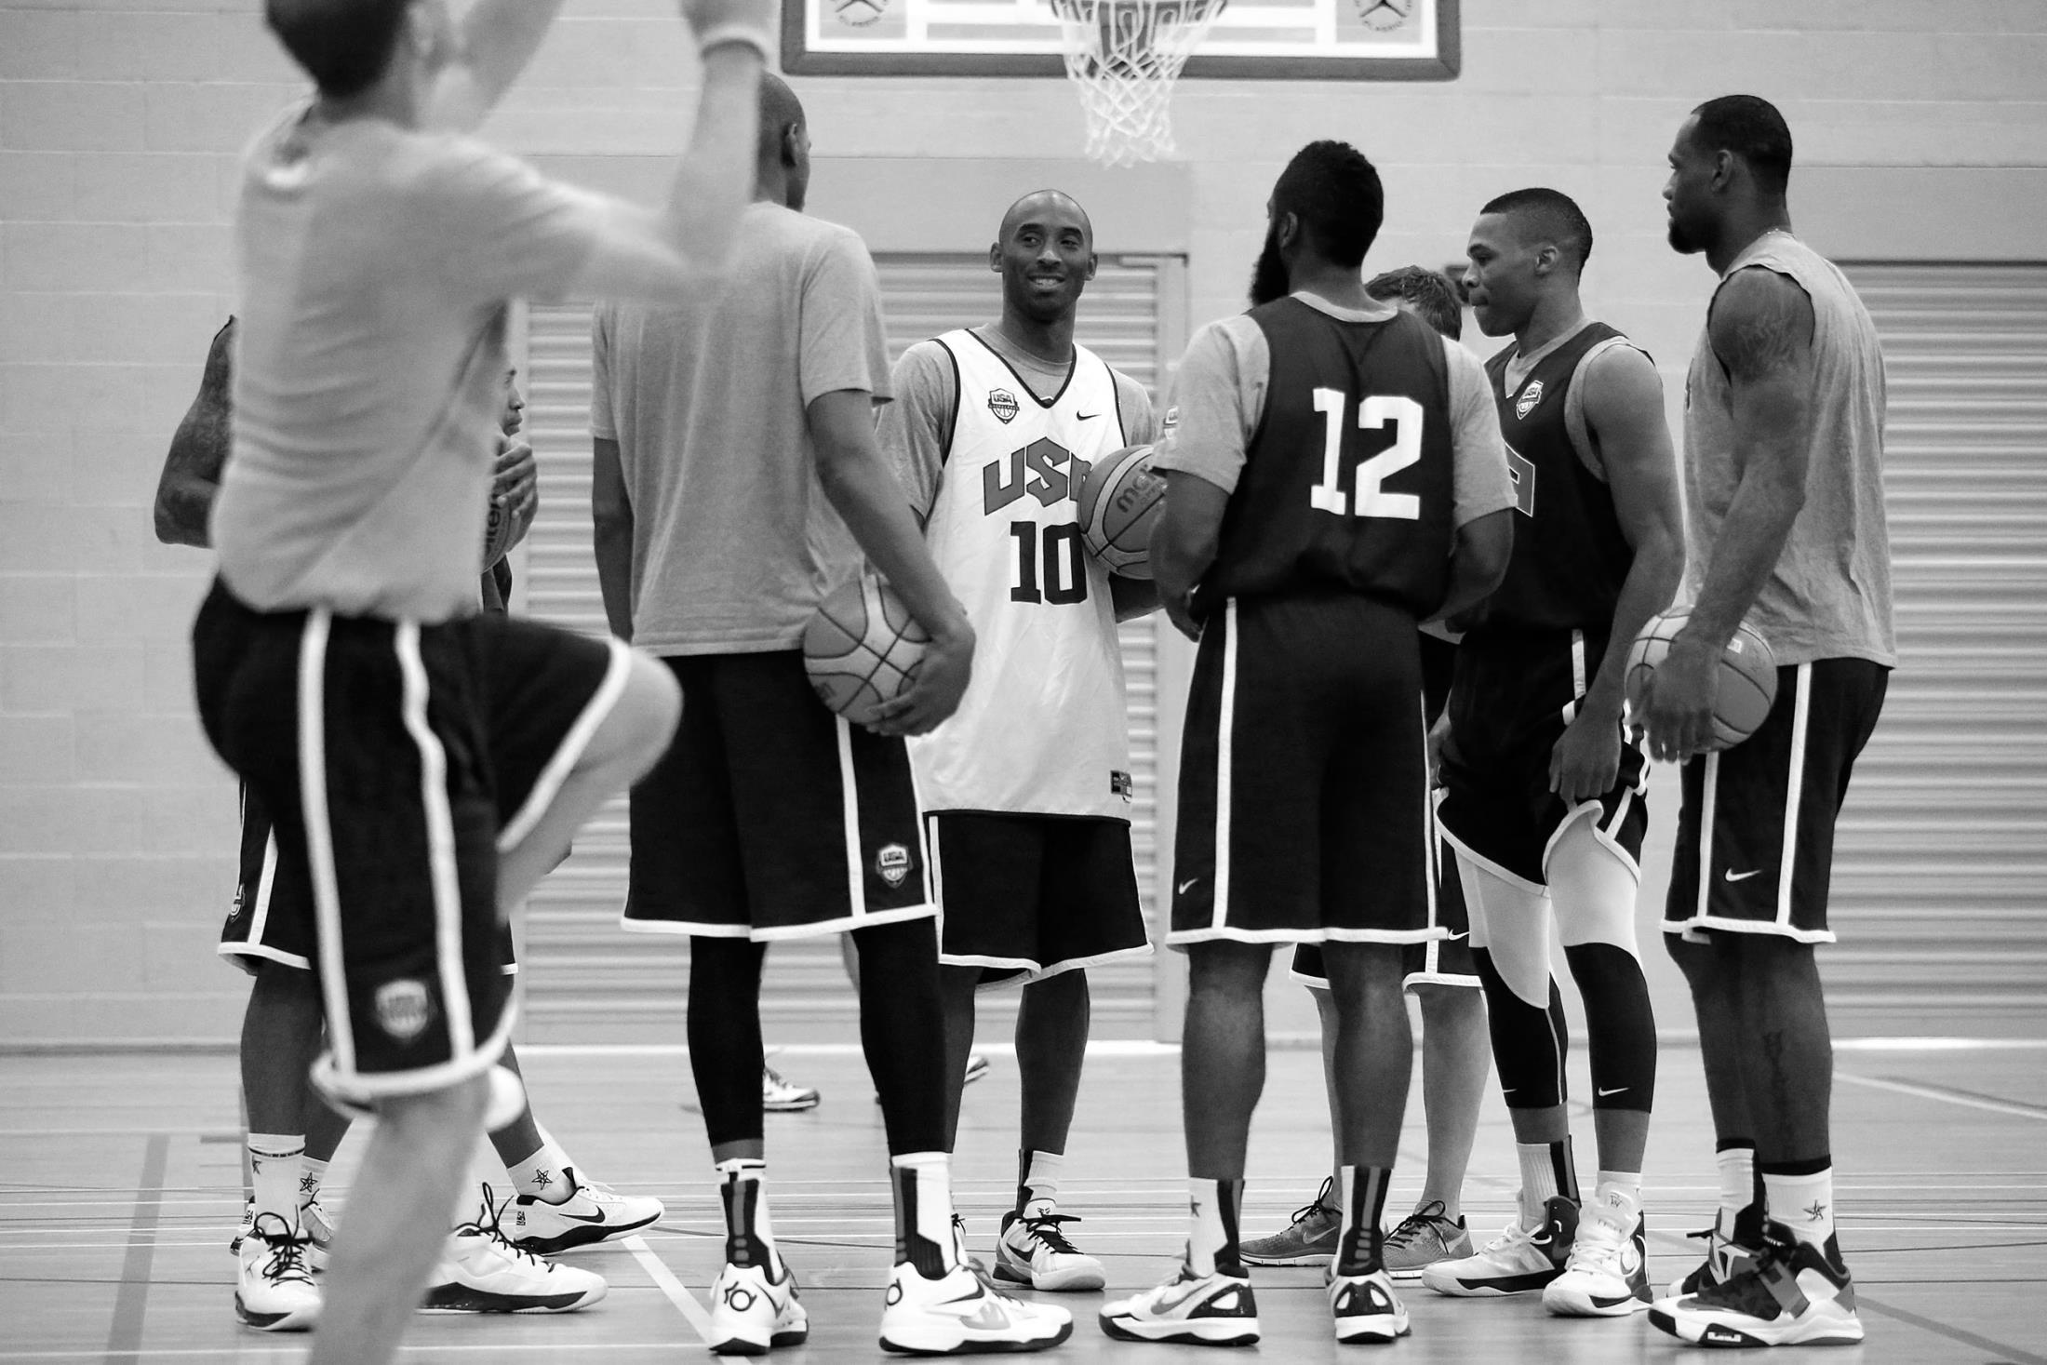
We always organize in teams
Notes:
The team will be the base for learning

Slide 4
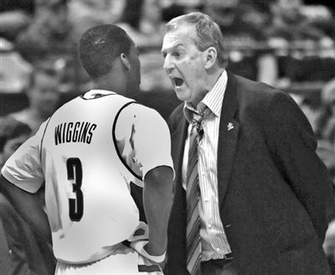
The role as a teacher is different
Setting the frames for development and exchange of compentencies within the team
Accept and realize that everybody dosen’t learn the same.
Dare to let go of the control.

Slide 5
Subject:
The TDC as a tool for development of
a team
Aim:
Go home with inspiration to how TDC can be used in your own teams/organization
Work method:
Enlightenment and structured dialogue
Notes:
The contract can either be pre-made or open
BUT it always consists of 3 elements

Slide 6
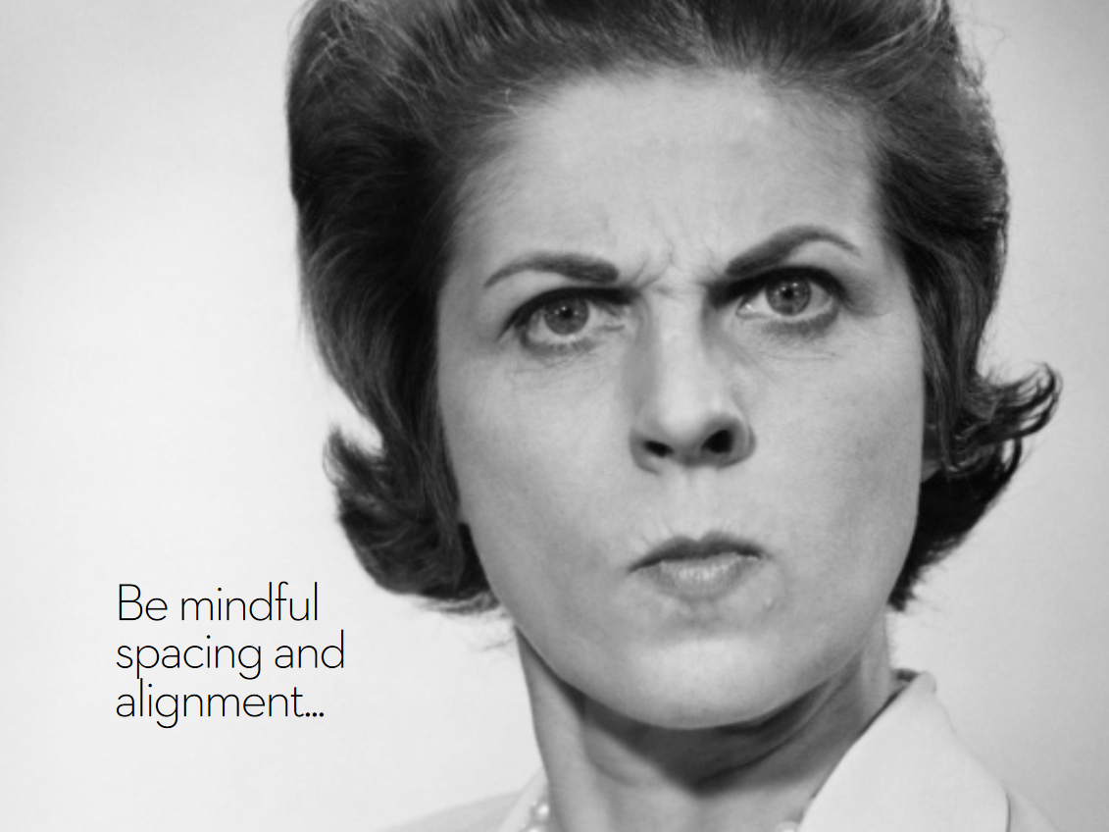
1) Everybody is responsible for co-creating the best possible result
2) Be curious and open to new things
3) To talk and listen is a right and duty
Notes:
The codes of conduct or the rules of the game

Slide 7
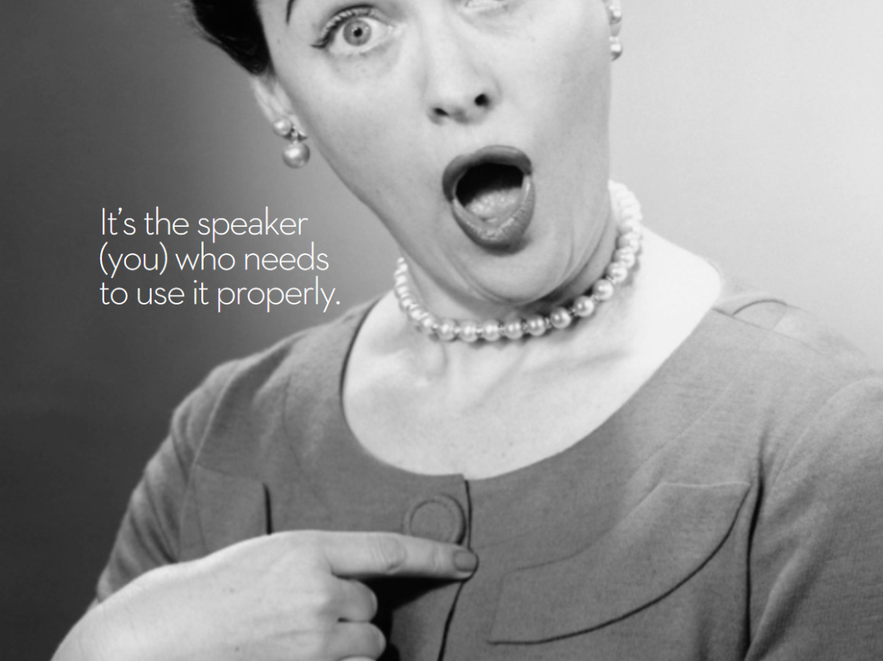
The game master
It could be you ………
Notes:
teacher, coach, consultant, leading a research group meeting etc.

Slide 8
The role of the game master
1) To control the proces - not the content
2) Meta-communication – take time-outs
3) Building bridges – from universe
to multiverse
Notes:
Control proces – not content: be clear of you role – right now I am not the gamemaster – I am giving you information
Meta-communcation: are we still on the right path according to our contract - making it clear what phases we are in
Multiverse: summing up, common features, helping people to relate to eachother

Slide 9
Subject:
The TDC as a tool for development of
a team
Aim:
Go home with inspiration to how TDC can be used in your own teams/organization
Work method:
Enlightenment and structured dialogue
Notes:
The contract can either be pre-made or open

Slide 10
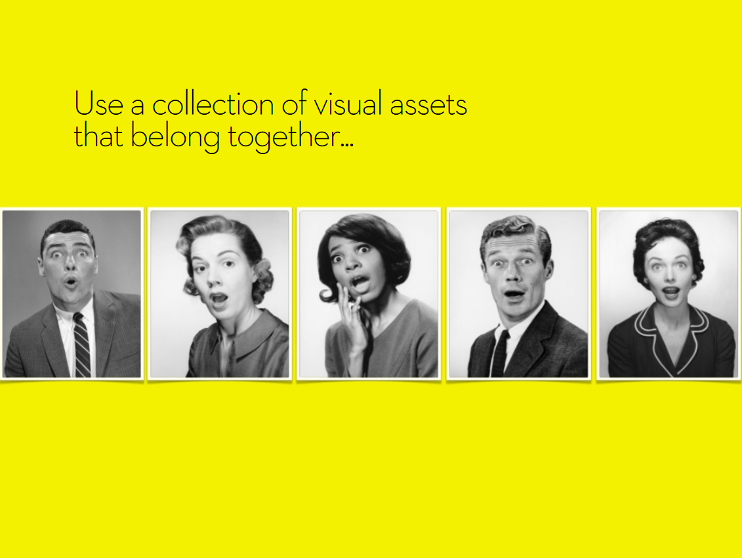
What impact did the Team Development
Conversation have on you?

Slide 11
What part of the TDC did you find
most interesting or inspiring?
How can you use the TDC as a tool as
consultant, ball games teacher, coach,
etc?
Notes:
1 minute with the person next to you

